Slide 1
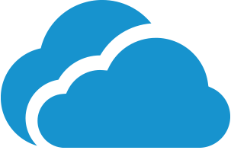

Covid-19 and Cloud Computing
Danish Ikhwan Bin Dalim
Nur Sarah Binti Rosli
Muhammad Saifullah Hasan
Nurul Aishah Binti Mohd Homri
Rasvin Kumar a/l Jaya Krishna

Slide 2
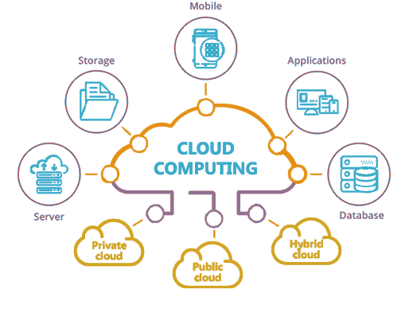
Introduction
Cloud computing is defined as the interactive utilization of computer system-based resources such as tools and applications like data storage, servers, databases, networking and software.
COVID-19 pandemic has compelled people to work from their homes, but they have to communicate, collaborate online.
Where, Cloud computing plays an important role in taking up this challenge of working from home and delivering efficiently.
COVID-19 also forces the integration of Cloud computing in order to track progress of Covid-19 cases and vaccination rate.
Cloud computing facilitates collaboration, communication, and essential online services during the COVID-19 crisis.

Slide 3
Key Features of Cloud Computing Services for Covid-19
Security
Key features of CCS for Cov-19
Scalability
Cost
Data Storage

Slide 4
Security feature of Cloud Computing Services for Covid-19
Cloud Computing Security ? Precautions & Encryptions
Facts about Cloud Computing Security Measures & Controls in Cloud Security
Risks
Cost feature of Cloud Computing Services for Covid-19
One Time Investment

Slide 5
Scalability of Cloud Computing Services for Covid-19
The ability of a computing process to be used or produced in a range of capabilities
Example ?
Data Storage of Cloud Computing Services for Covid-19
Types of Cloud Storage Use for Cov-19 Encryption & Prevention of Data Loss
Advantages & Risk Precautions to Protect the Data
Infrastructure Data Protection Process

Slide 6
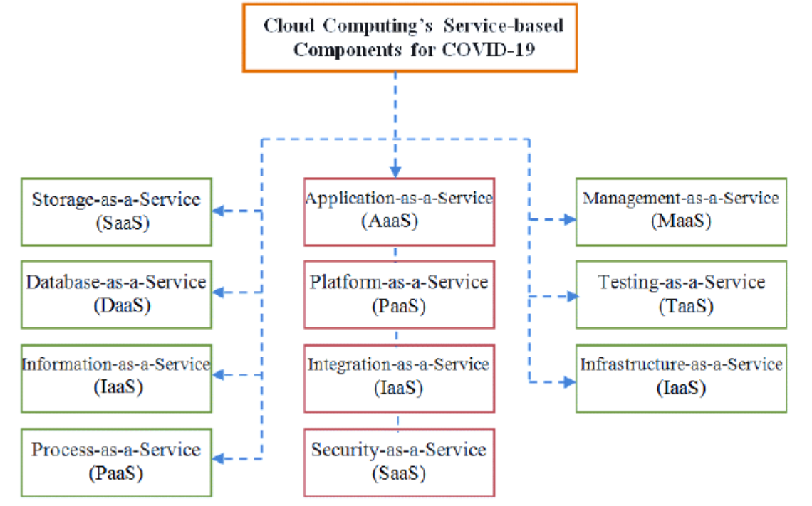
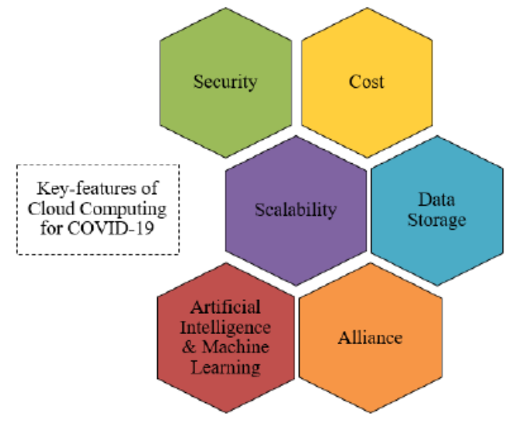
Cloud Computing’s Service-based for COVID-19 Pandemic

Slide 7
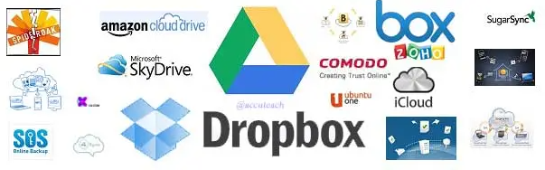
Application
Online data storage - is a virtual storage model that lets users and businesses upload their data across Internet channels to a remote data network.
Data is stored in the cloud, or stored on servers that are not owned by the person using them. Other users can also access the same infrastructure. It's like a cloud in that we can all see the same cloud in the sky but no single individual owns it, yet we can each access it.
Remote mapping - is the process of modifying or adding in new data to areas from a distance. Usually it involves the use of a software program, tracing information from satellite imagery, and then uploading the results so that it can form part of the map data.
Application mapping - is a process used to discover and map all components and interdependencies of an organization's business processes and applications, including software, servers, storage, security, networking infrastructure and data flow.

Slide 8
Data Safety
Spreadsheets
Online Treatment Facilities
Helps user to find and/or share information:
Sars cov-2 symptoms
Initial treatments and/or precautions
Current covid cases in country and/or state
Number of vaccinated populations
Acts as helpdesk for:
Close contact and covid19 patients to communicate in medical personnel
The information and the records will be shared to public
Implement basic and file-level encryption measures (only correct authentication is permitted to access).
Application of Cloud Computing in Covid-19 Cont.

Slide 9
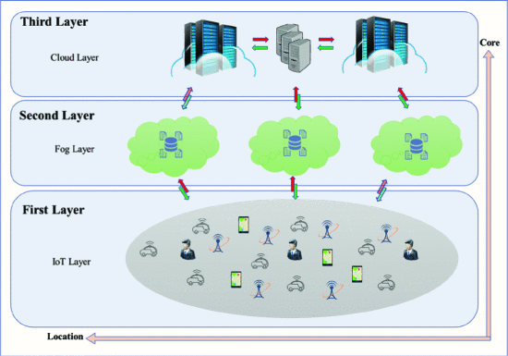
Application of Cloud Computing in Covid-19 Cont.
IoT Layer - MYSejahtera app
Fog Layer - any devices that provide computing, storage & connectivity
Cloud Layer - IaaS, SaaS, PaaS or BPO
Source: T. -A. N. Abdali, R. Hassan and A. H. Mohd Aman, "A New Feature in Mysejahtera Application to Monitoring the Spread of COVID-19 Using Fog Computing," 2021 3rd International Cyber Resilience Conference (CRC), 2021, pp. 1-4, doi: 10.1109/CRC50527.2021.9392534.

Slide 10
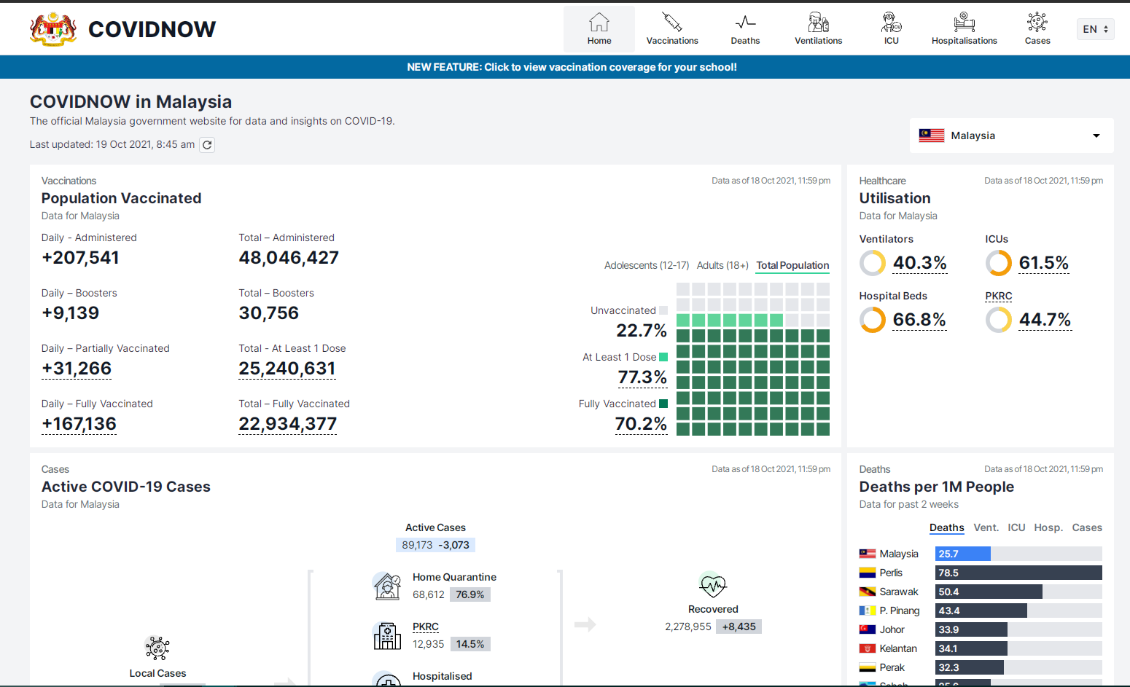
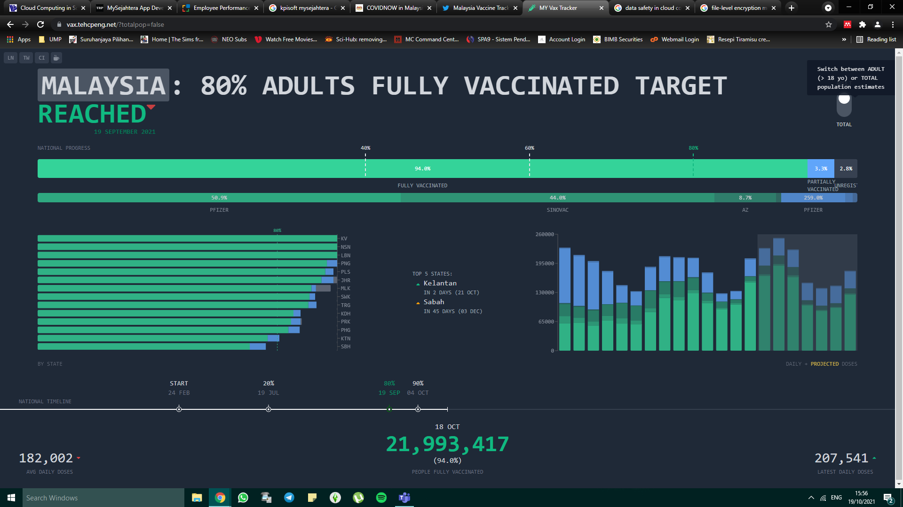
Example of Application of Cloud Computing for Covid19
Source: COVIDNOW website for insights and data for Covid-19
Source: MY Vax Tracker (develop by Malaysian Developer

Slide 11
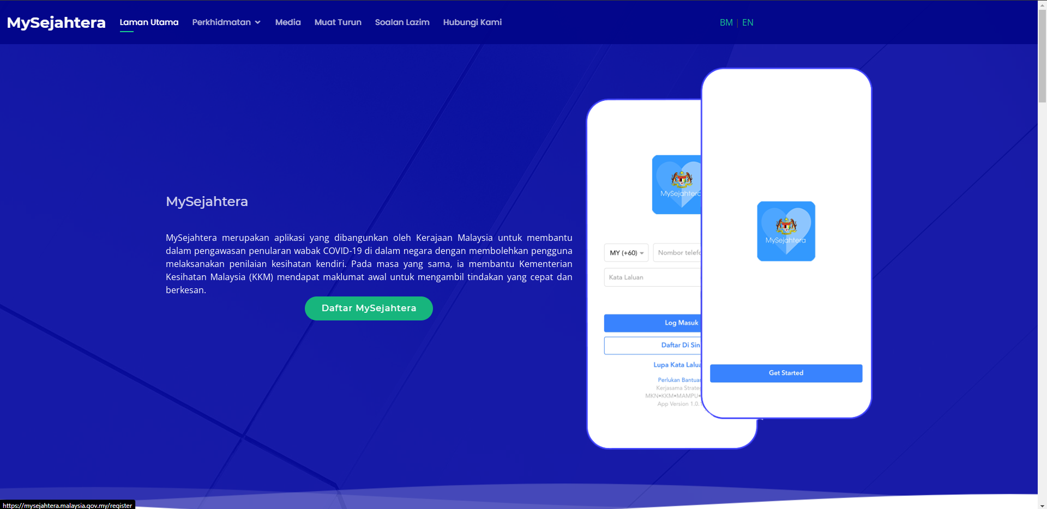
Example of Application of Cloud Computing for Covid19 Cont.
Source: MYSEJAHTERA Website

